Slide 1



Loud Speaker

Slide 2
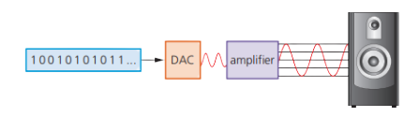
How loud speakers work?
Digital data is passed to a DAC (Digital to Analogue Converter).
DAC converts the signal to an electric current.
The signal is sent to an amplifier to increase its strength.
The loudspeaker converts the current into sound.

Slide 3
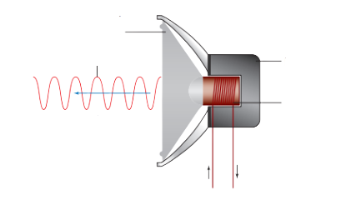

Loudspeaker Internal Mechanism
plastic or
paper cone
Electric current is fed to a coil of wire.
The coil is wrapped around an iron core, placed near a permanent magnet.
Current causes the cone (paper or plastic) to vibrate.
Vibrations produce sound waves.
Sound waves
Permanent
magnet
coil of wire wrapped
around an iron core
Sound waves
produced
electrical current
fed to wire

